Slide 1

Team Code : c2de455d
Smart Automated Simulation Software for Irrigation
Problem STATEMENT : SMART AUTOMATION
Team Members :
ADINATH GHOSH (20051418)
ALOK SAHAY (20051195)
ARYAN NARAYAN (2005015)
HRITIK AYUSH (20051008)

Slide 2
Existing technologies in India
Most of the rural areas in India used basic manpowered techniques of Irrigation such as :
Well & Tube Well Irrigation ,Canal Irrigation ,Tank Irrigation ,Furrow Irrigation ,etc.
Talking about these non-automated systems of irrigation :
: typically ,non-automated systems can be much time-consuming and labor-intensive as they require manual operation and monitoring which eventually increases overall cost of irrigation.
: they can result in over-flowing/wastage of water .
: particularly in times of draught situations ,these water resources dry-up due to which irrigation becomes a major concern for farmers out there in rural areas .
: in addition to all these de-merits ,non-automated systems can lead to uneven watering and soil moisture levels, which can harm crops and reduce their overall quality.

Slide 3
Our Solution:
IoT Based Smart Automated Irrigation and Agricultural Solutions :
Countries are working into making agriculture more sustainable by integrating different technologies to enhance its operation .
Our Automated prototype aims of implementing SMART Irrigation using IOT and sensory systems .Linked with IoT and automation, these automations can make the whole process much more effective and efficient .
Moreover with these automations ,they can even help in soil and weather monitoring along with efficient water management .
IoT can be thought of as an extension of the current internet to all devices that can communicate with electronic equipments and are linked to the internet, making devices user friendly and easy to handle ,so farmers can be educated about their operations conviniently .

Slide 4
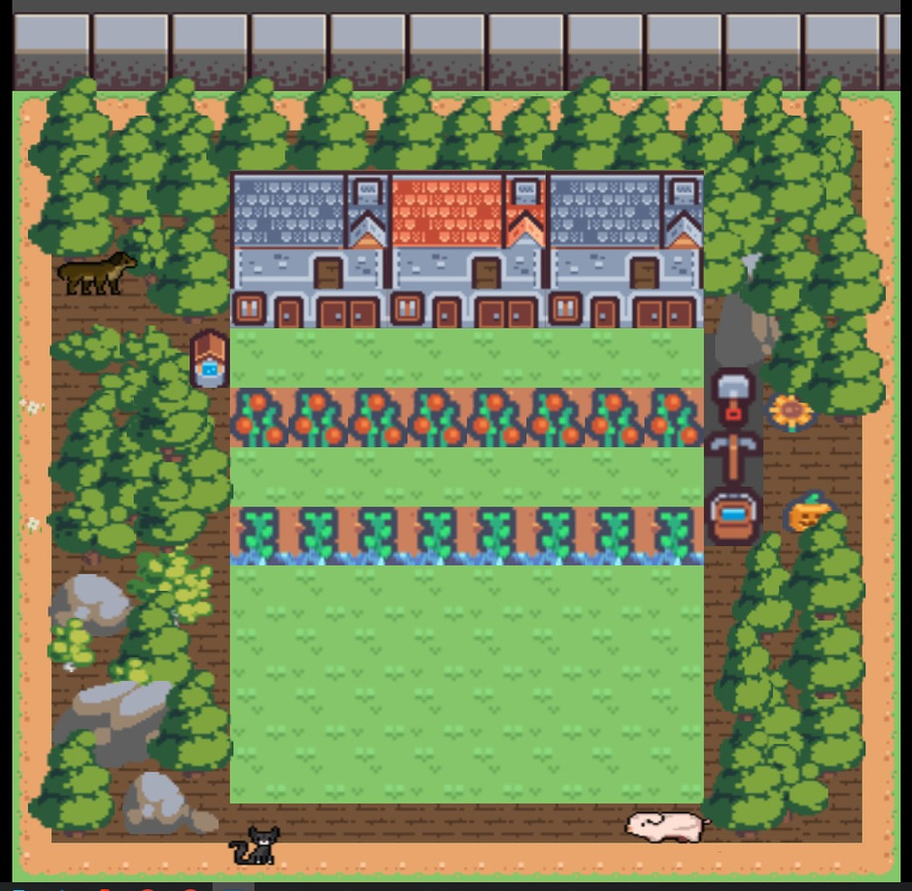
developed in Godot Engine
Simulation Software :
Using GdScripts

Slide 5
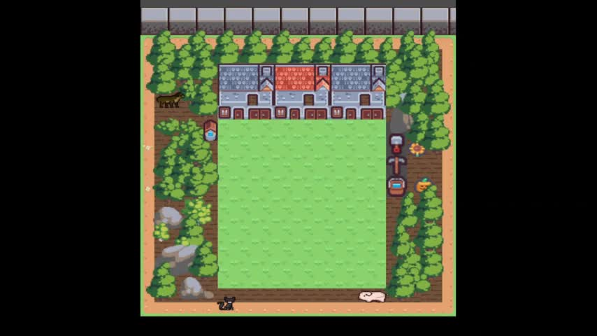
Demonstration :
Back to Agenda Page

Slide 6
Proposed Working :
Basically , through our Automated Prototype ,we are trying to present how an automated irrigation and agricultural system would help our Indian farmers get in with efficient irrigation and agriculture techniques .It would help in reducing excess manpower and would also save water ,maintain crop quality based on soil type , weather conditions monitoring .This automation ,acquainted with IoT and sensory mechanisms would automatically control amount of water flow to the harvesting areas . Using this automation ,optimal amount of water would be supplied to the crops at proper intervals of time .

Slide 7
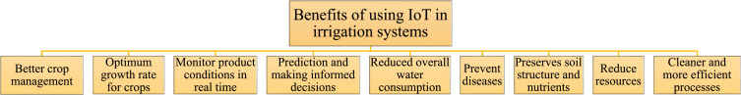
The system continuously monitors the water level in the tank and provide accurate amount of water required to the plant or crop .
Precise method for irrigation and a valuable tool for accurate soil moisture control in highly specialized greenhouse vegetable production .
Saving energy and resources, so that it can be utilized in proper way and amount.
Time saving, and human error eliminated in adjusting available soil moisture levels.

Slide 8


Technologies/Components Used :
Godot Engine.
Gd-Script Language for Coding part .
Digital Graphics and Pixel-Art

Slide 9
Benefits to Society
Optimal harvests results in increased wages of the farmers
This will lead to increase in export capacity of the country

Slide 10
CONCLUSION
We have developed this software to help farmers increase their harvest amounts and ease their way of living and providing better standards of income.
Using IOT based irrigation can reduce their labour exponentially and even though this project is in its early stages we hope to further develop this software so that one day it can be applied to everyone in the agriculture industry.

Slide 11


